Slide 1
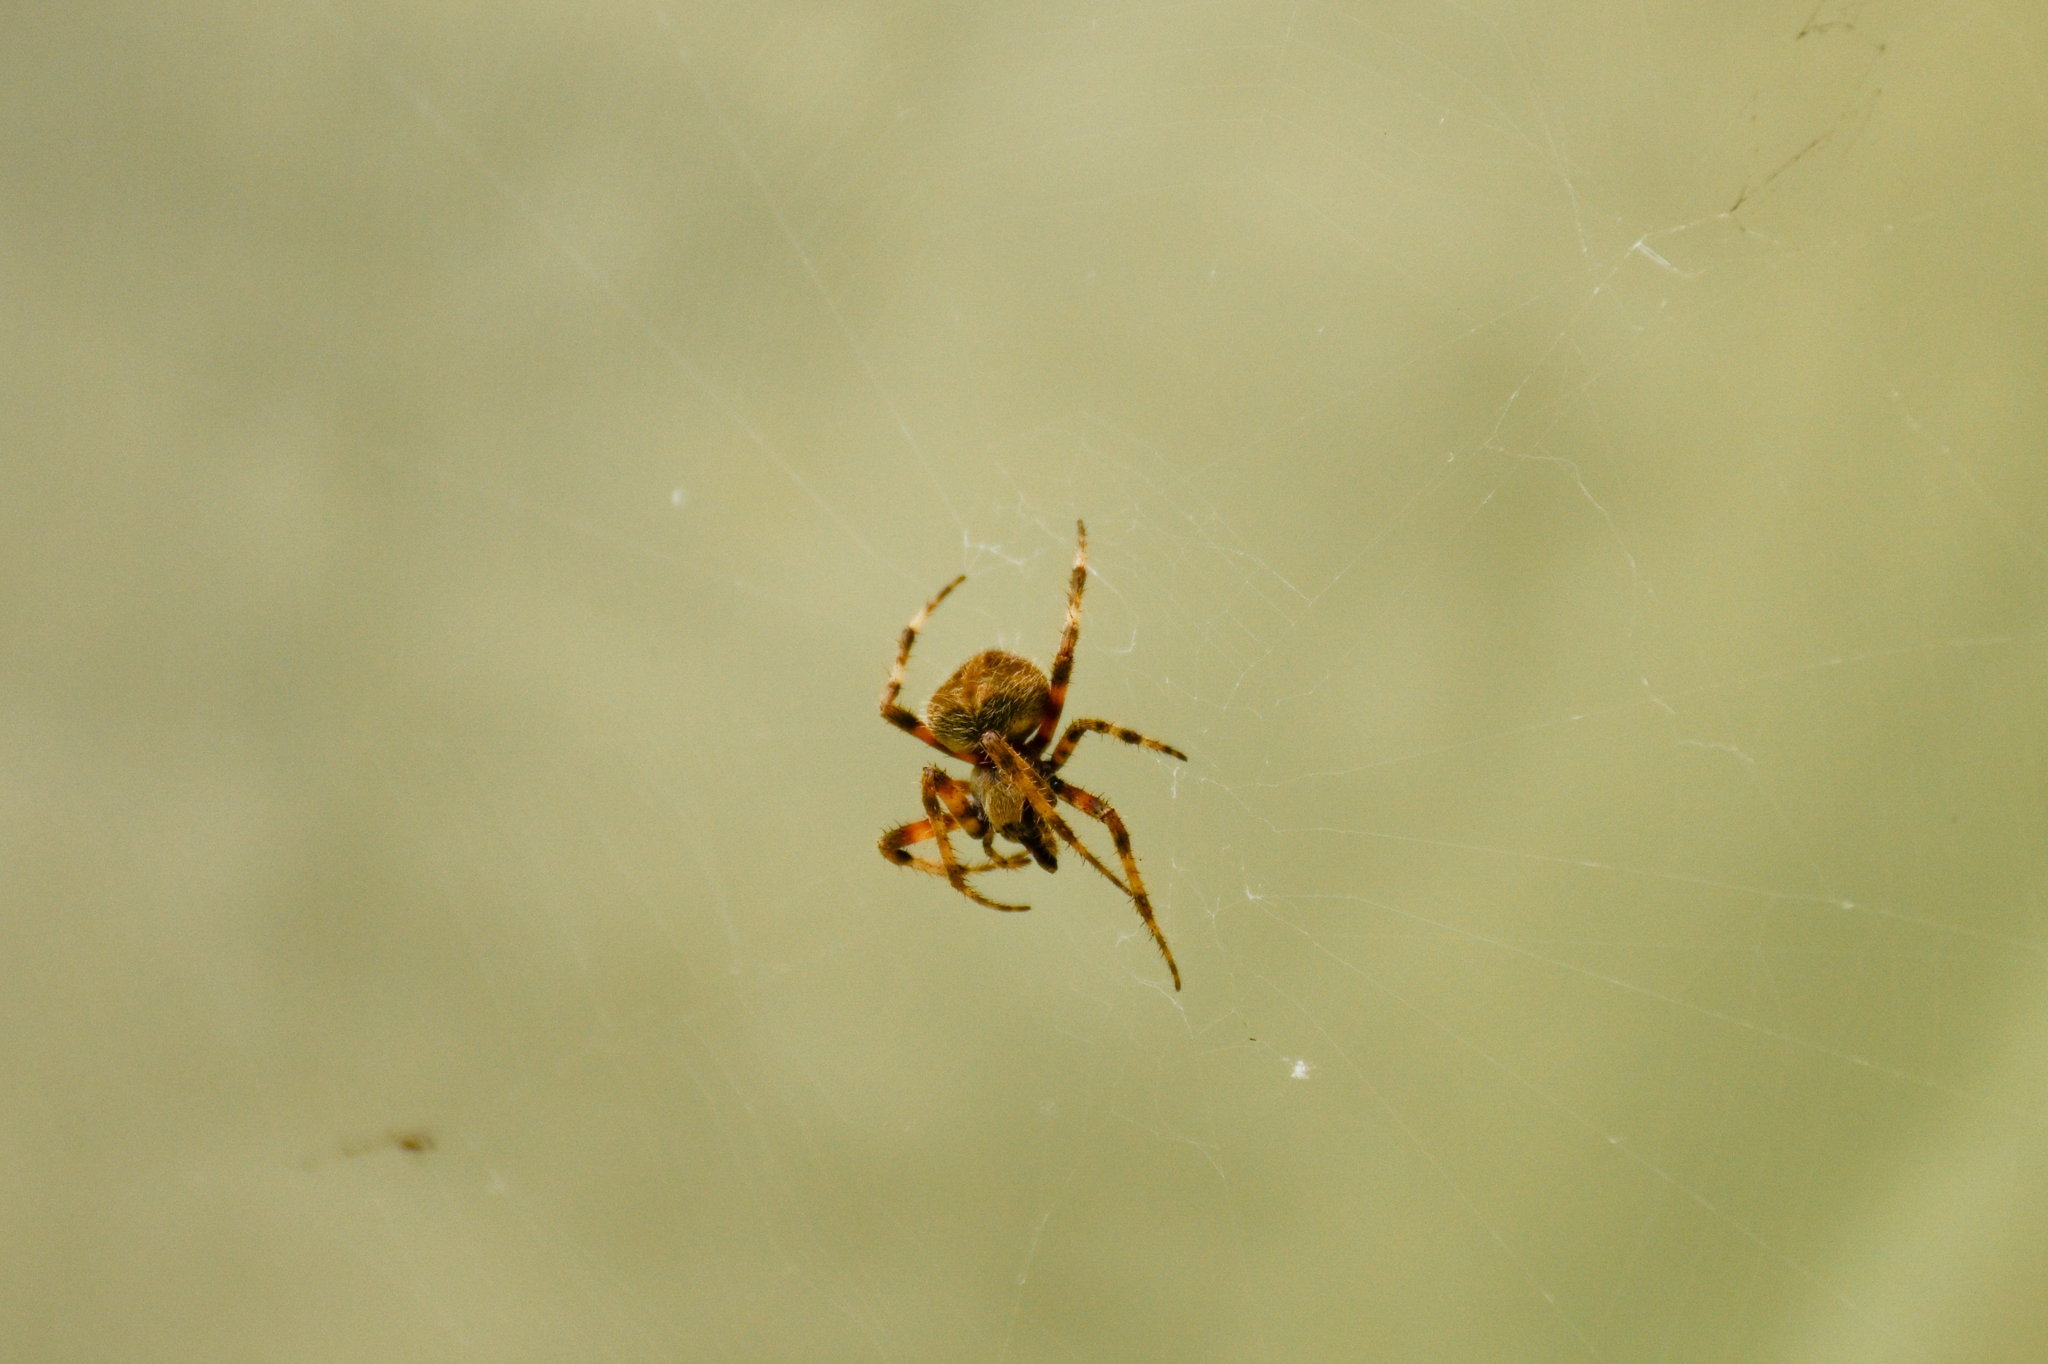
Imagine you are a…spider
Spiders have eight legs
Most spiders have eight eyes!
Not all spiders spin webs, but they all make silk, which is very strong and stretchy
Some spiders use their webs to catch food, while others wait to catch their prey

Slide 2
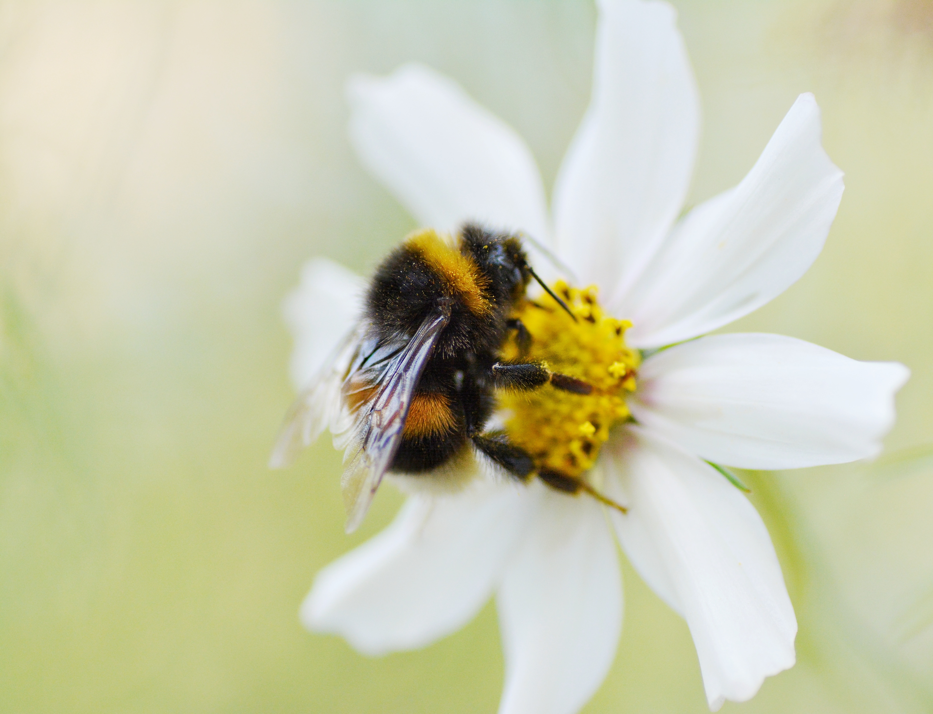
Imagine you are a…bumblebee
Bees have four wings
Bumblebees collect nectar and pollen from flowers
They make a buzzing noise which shakes pollen off the flower
They burn a lot of energy and have to eat almost continuously!
Most bumblebees are social insects and live in groups called colonies

Slide 3
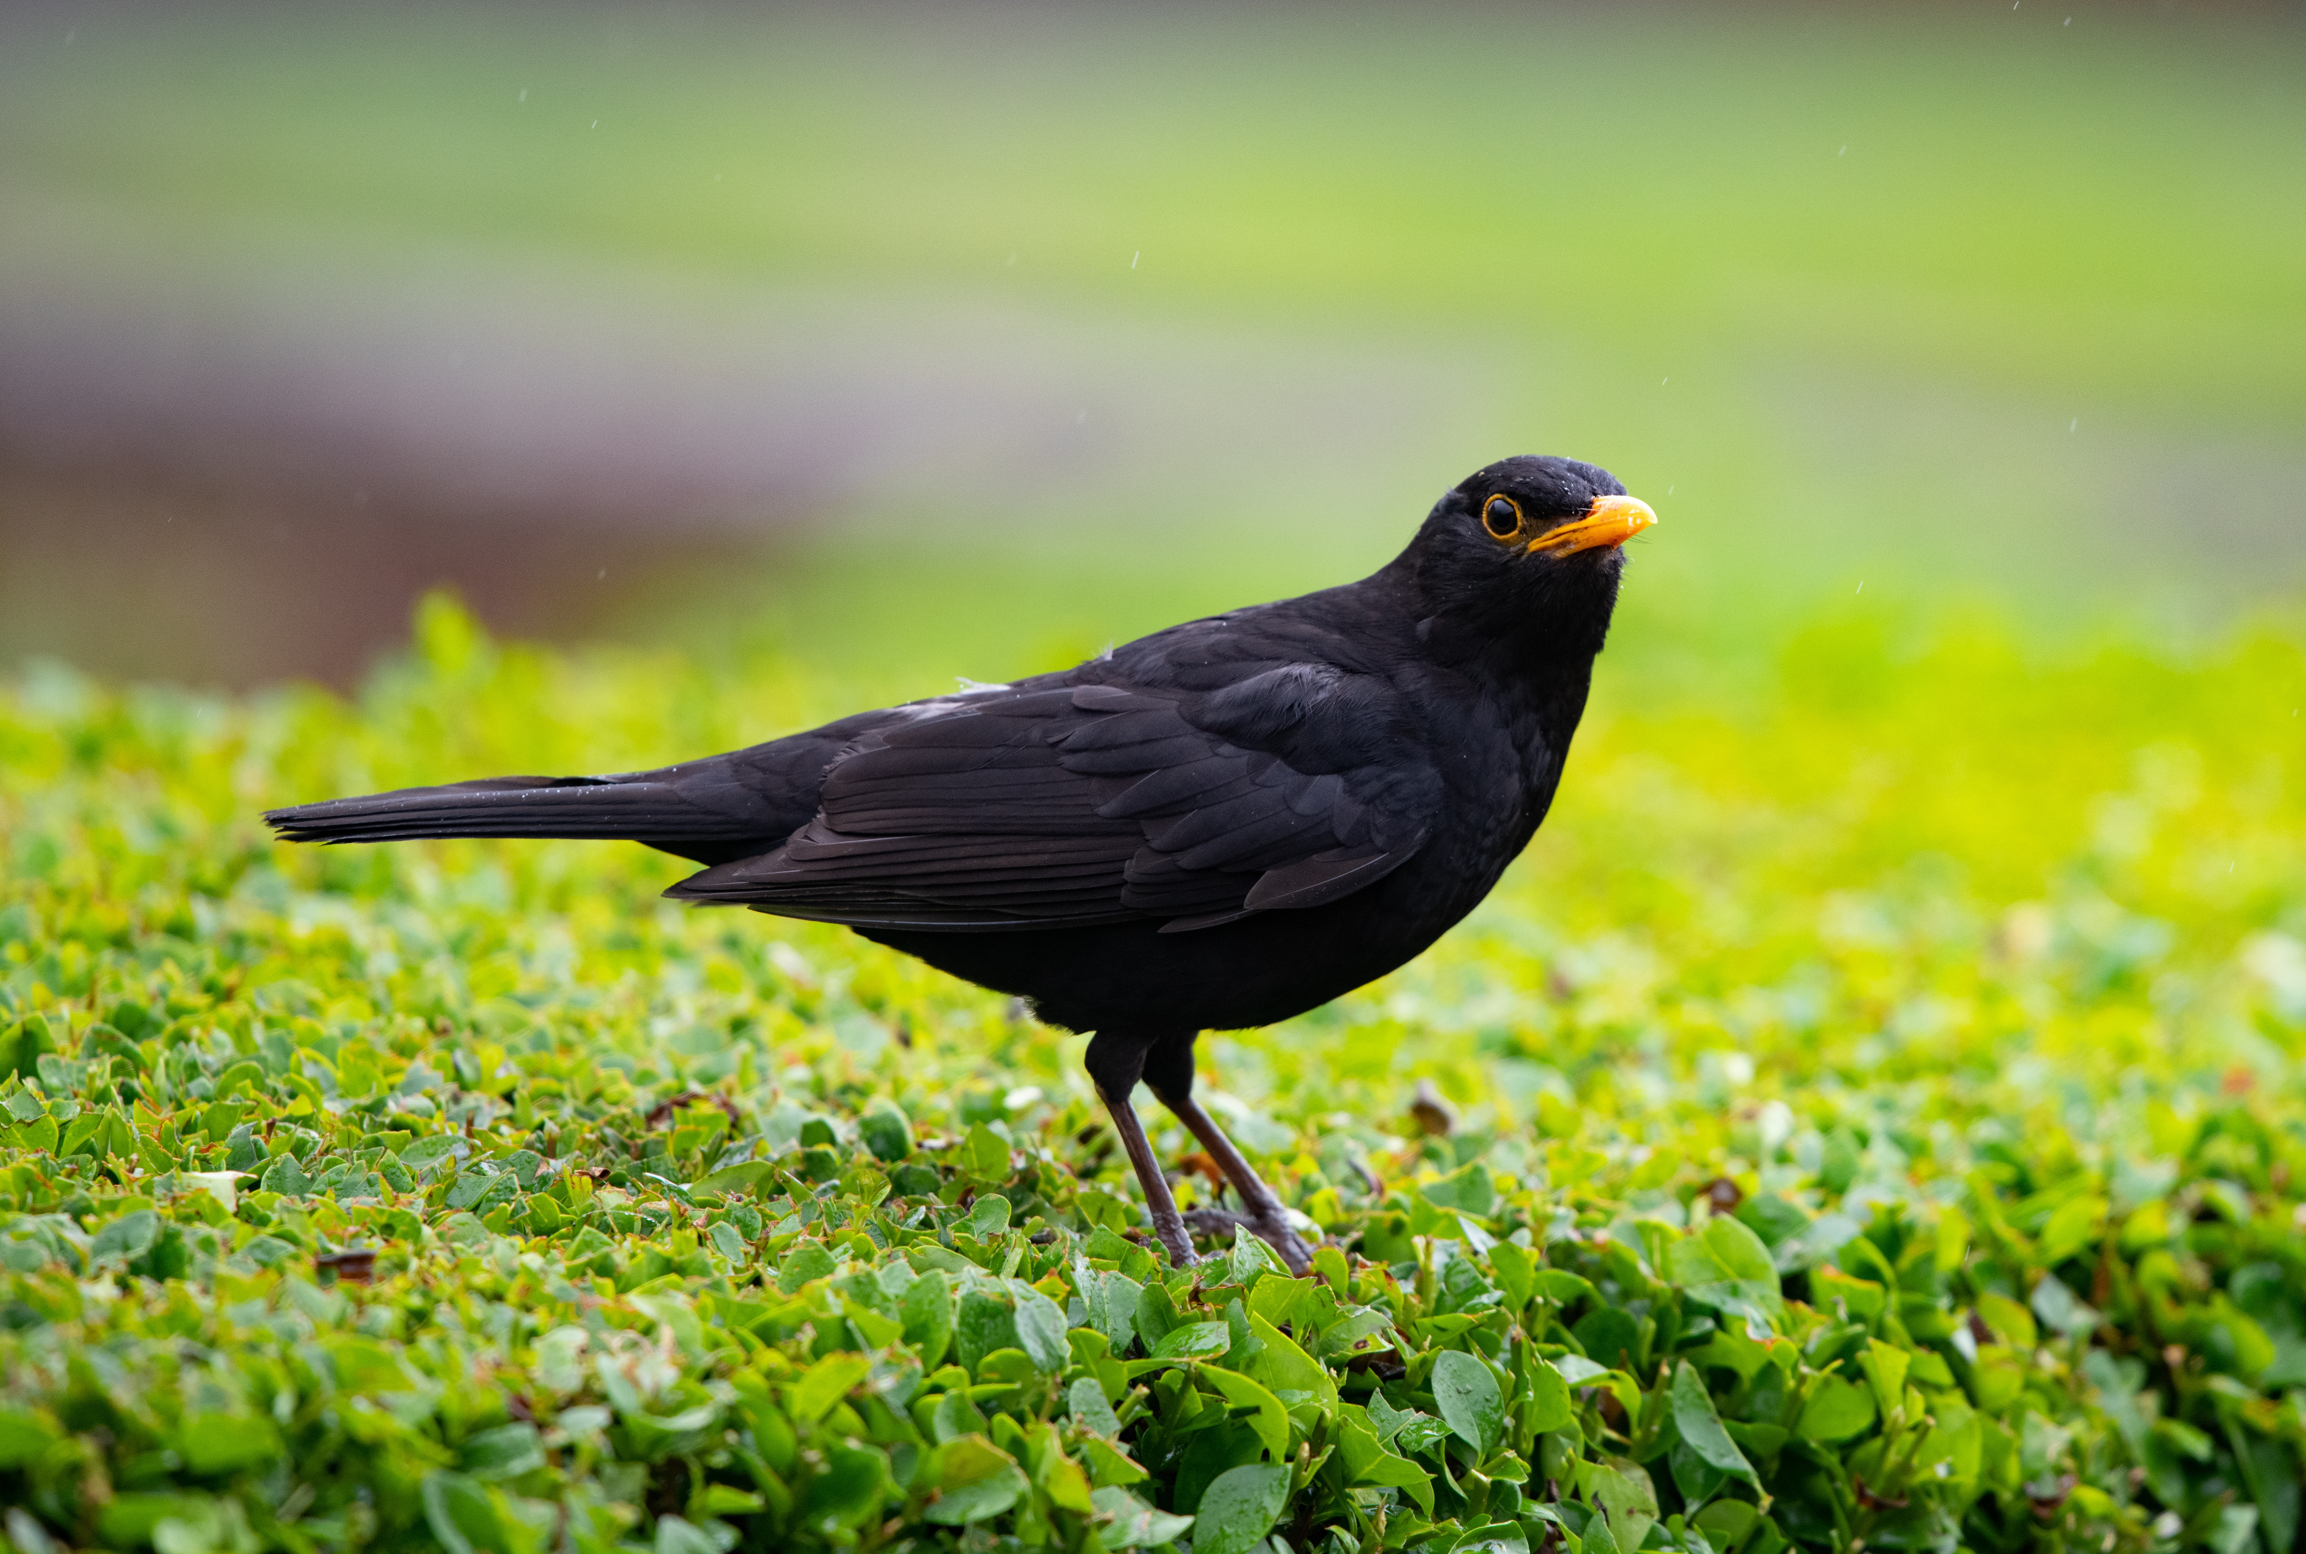
Imagine you are a…blackbird
Birds’ feathers help them to fly, attract mates and keep them warm
Blackbirds eat insects and worms, but also berries and fruit
They make nests low down in trees, shrubs or even on the ground
You can often see blackbirds in pairs

Slide 4

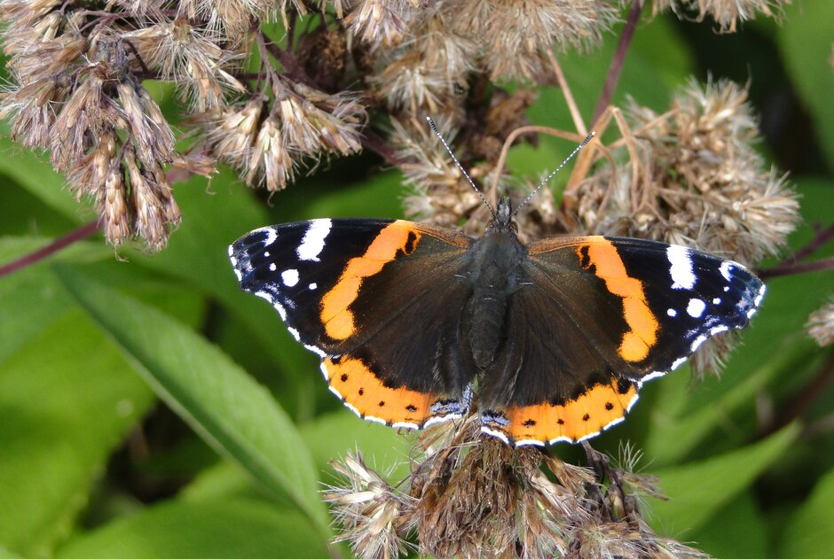

Imagine you are a…butterfly
Image © RHS, RHS / Helen Bostock
Butterflies are insects that have four wings
They are often brightly coloured and patterned
Caterpillars are the larvae of butterflies
Butterflies mainly feed on nectar from flowers using a long tube, like a straw
They use their antennae to sense wind and smells in the air

Slide 5

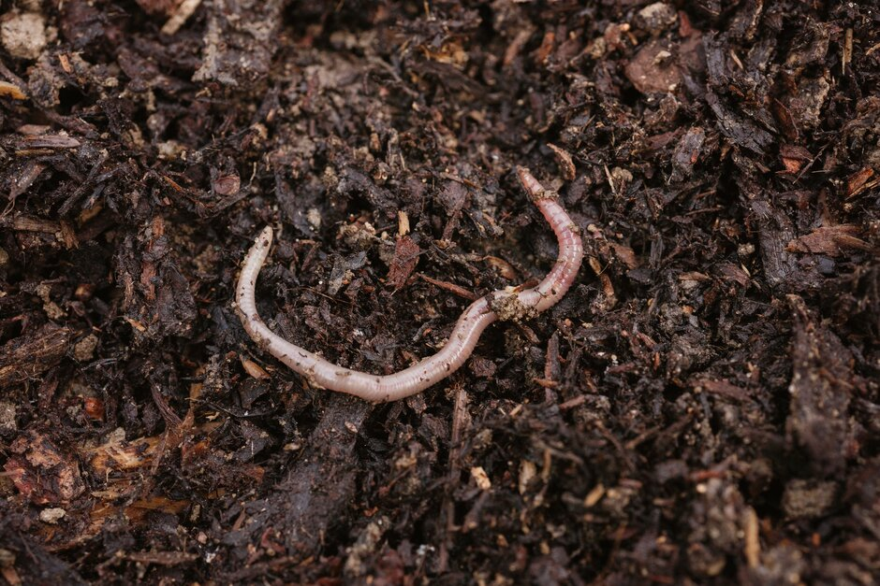

Imagine you are a…worm
Worms are often found in moist soil
They have a soft, tube-like body
Worms eat and break down organic matter around them – they can eat their own body weight in food every day!
Worms have no eyes but can sense light, as well as vibrations in the earth
Image © RHS, RHS / Georgi Mabee

Slide 6

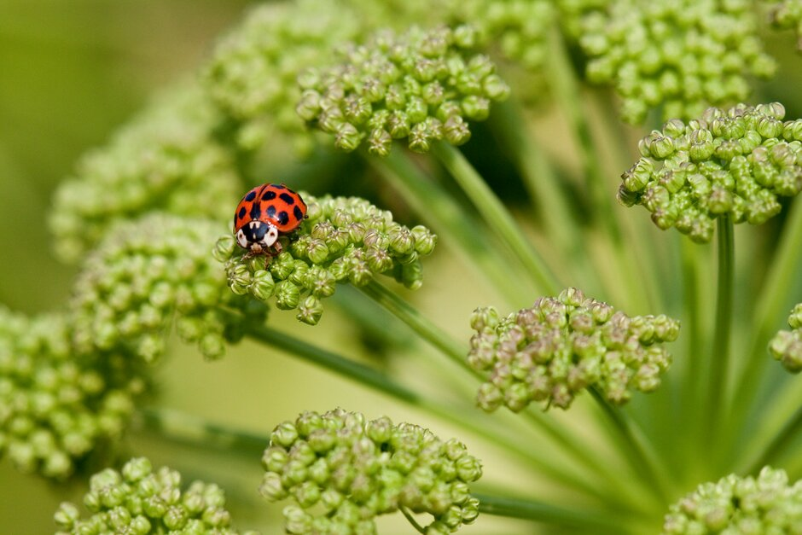

Imagine you are a…ladybird
Ladybirds are beetles that range in size from 1 to 10mm
Many ladybirds are predatory, feeding on tiny insects – they can help keep these insects under control and are good for your garden
Grown up ladybirds shelter over winter in groups
In spring they reproduce
Image © RHS, RHS / Carol Sheppard

Slide 7

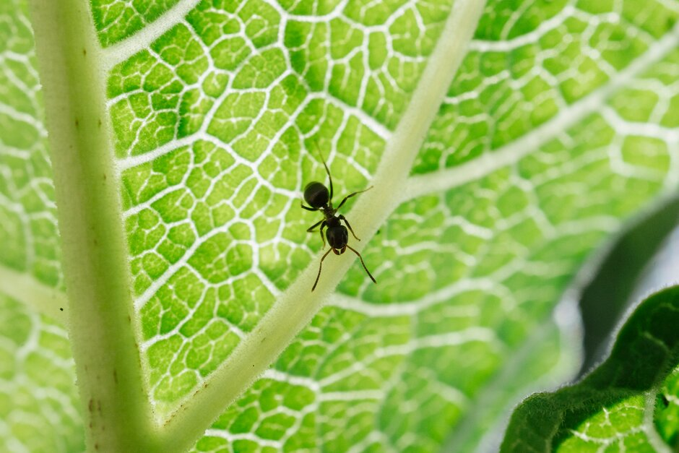

Imagine you are an...ant
Ants have six legs
Ants are important insects in gardens. Although ants can cause concern, they are an important part of biodiversity
They live in nests of hundreds and sometimes thousands of ants! Their nests can be found in dead wood or soil
Most ants are wingless females, known as workers
Ants feed mainly on minibeasts, including other ants
Ants can carry 50 times their body weight!
Ant queens can live for up to 20 years, whilst male ants often only live for a few weeks
Image © RHS, RHS / Georgi Mabee

Slide 8

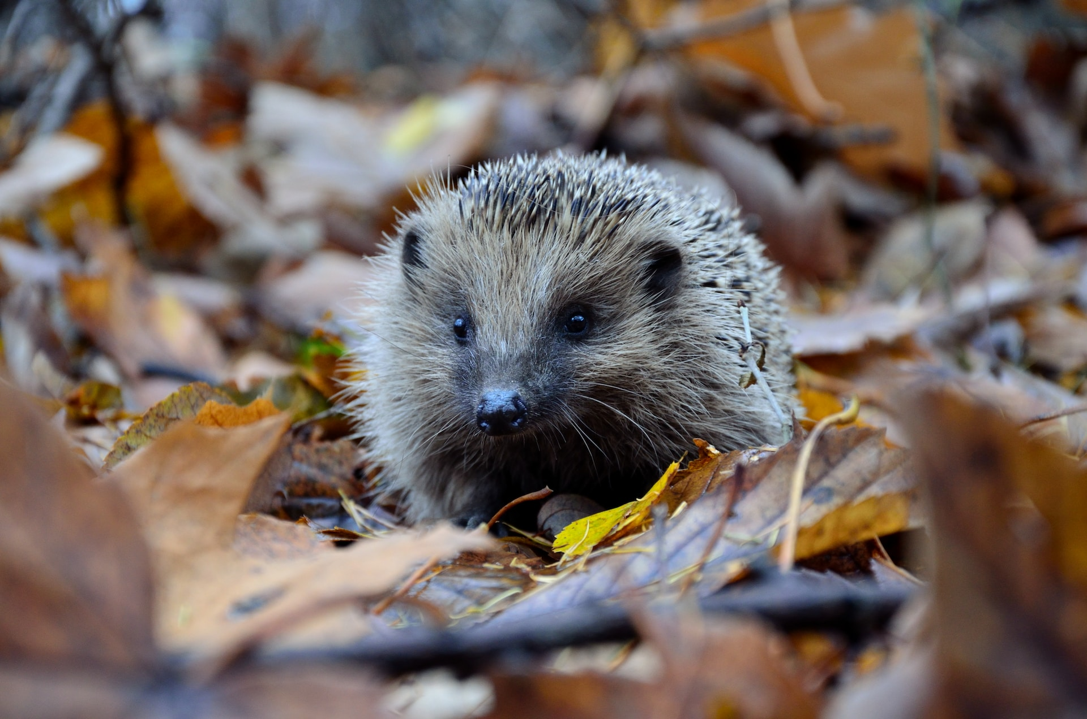

Imagine you are a…hedgehog
Hedgehogs are nocturnal (they sleep during the day, and wake up at night)
Hedgehogs are solitary animals and live alone as adults
They have long snouts which help them hunt for food, as their eyesight isn't very good
They have thousands of spines on their backs which act as protection - they will often curl into a ball if threatened

Slide 9

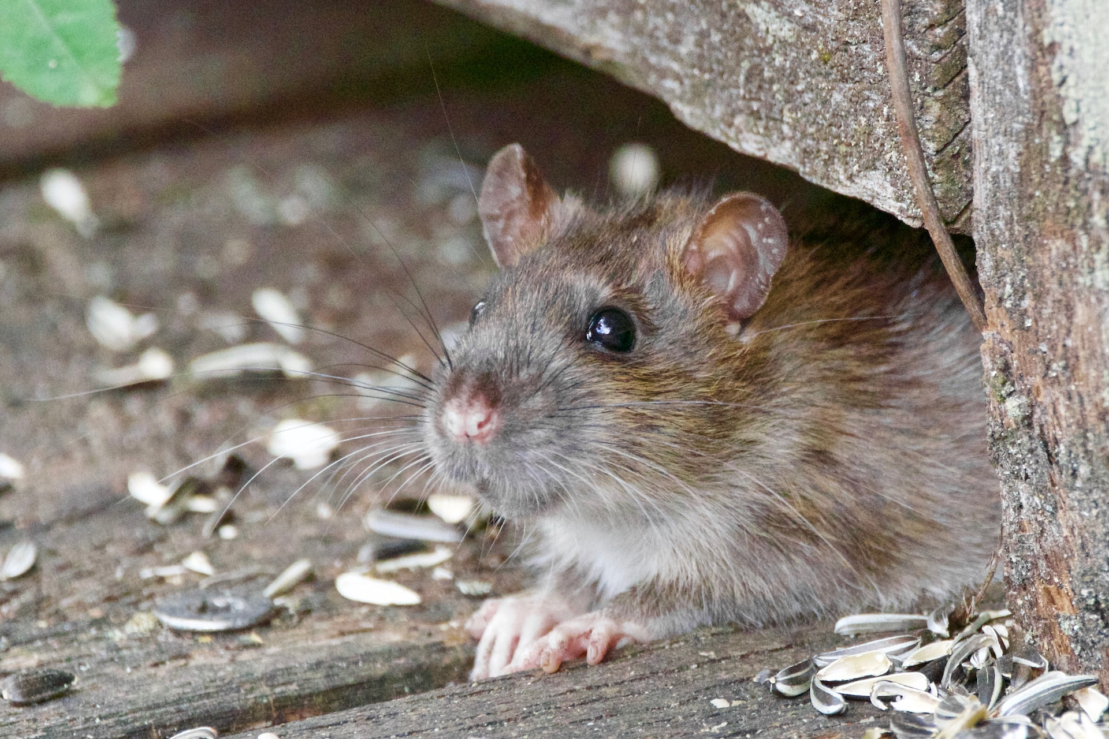

Imagine you are a…rat
Brown rats are found almost everywhere in the UK! They are very common in towns and cities
Rats eat almost anything, from fruit and seeds to human food, insects and even small animals
They dig burrows for shelter
Rats are nocturnal, and good swimmers!

